Slide 1
Spatial and numerical associations in graphs

Slide 2
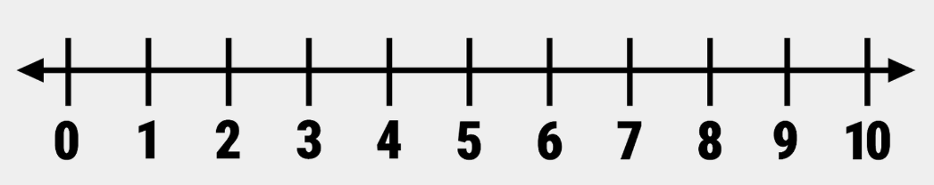
Cultural tools influence cognition

Slide 3
Cultural tools influence cognition
Spatial Numerical Associations of Response Codes effect (SNARC)
Dehaene, Bossini & Giraux, 1993)

Slide 4
SNARC effect
Participants asked to press right key if numeral is even and left if numeral is odd
9
Dehaene, Bossini & Giraux, 1993)

Slide 5
SNARC effect
Participants asked to press right key if numeral is even and left if numeral is odd
4
Dehaene, Bossini & Giraux, 1993)

Slide 6
SNARC effect
Participants asked to press right key if numeral is even and left if numeral is odd
8
Dehaene, Bossini & Giraux, 1993)

Slide 7
SNARC effect
Big numbers were slow with left hand and small numbers with right
We associate large numbers with the right side of space and small numbers with the left
Dehaene, Bossini & Giraux, 1993)

Slide 8
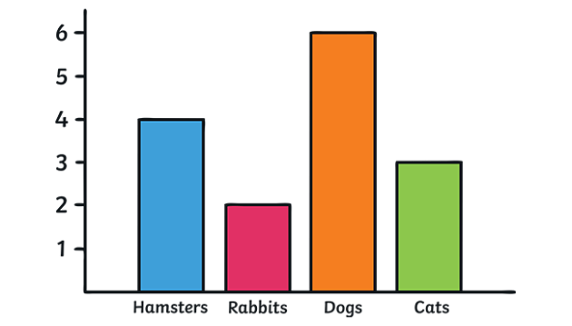
Graphs
One of the earliest symbolic tools used to depict spatial, temporal, and numerical information (e.g., maps)

Slide 9
Graphs
One of the earliest symbolic tools used to depict spatial, temporal, and numerical information (e.g., maps)
Rely on basic non-symbolic magnitudes to express these relations

Slide 10
Graphs
One of the earliest symbolic tools used to depict spatial, temporal, and numerical information (e.g., maps)
Rely on basic non-symbolic magnitudes to express these relations so do not require explicit mathematical knowledge
Big Question: what basic abilities or intuitions underlie graph perception and, like other symbolic systems, do graphs influence those things?

Slide 11
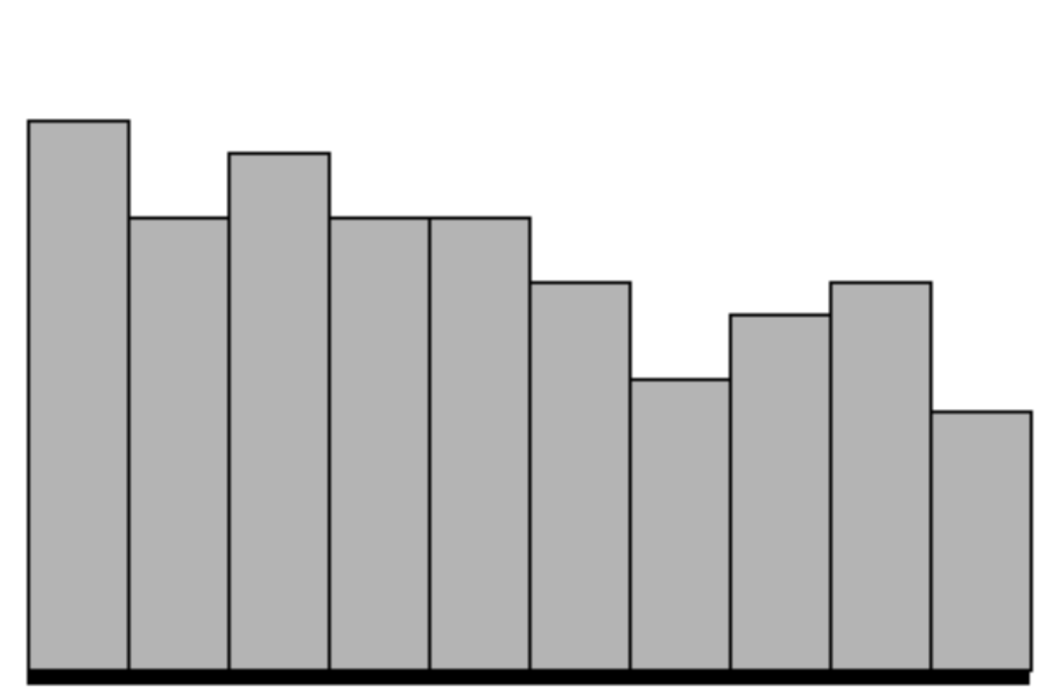
A SNARC effect in graphs?
Numerals depict scaler magnitudes and graphs depict relations of magnitudes
3
8

Slide 12
A SNARC effect in graphs?
Numerals depict scaler magnitudes and graphs depict relations of magnitudes
Similar to the SNARC effect there might be canonical spatial associations with different relations (decreasing versus increasing)
3
8

Slide 13
A SNARC effect in graphs?
Decreasing graphs were more slowly perceived in the right of the screen and increasing in the left (Parrott et al., 2014)
Is the bias graphical/mathematical in nature or is it a low-level effect?

Slide 14
Research Question
Does the bias in which certain spatial positions are compatible with certain relations in graphs depend on experience with graphs?
RQ1 (replication): are increasing graphs judged slower in the lower and left part of a display and decreasing in the upper and right?
RQ2: is this bias exacerbated with more experience?

Slide 15
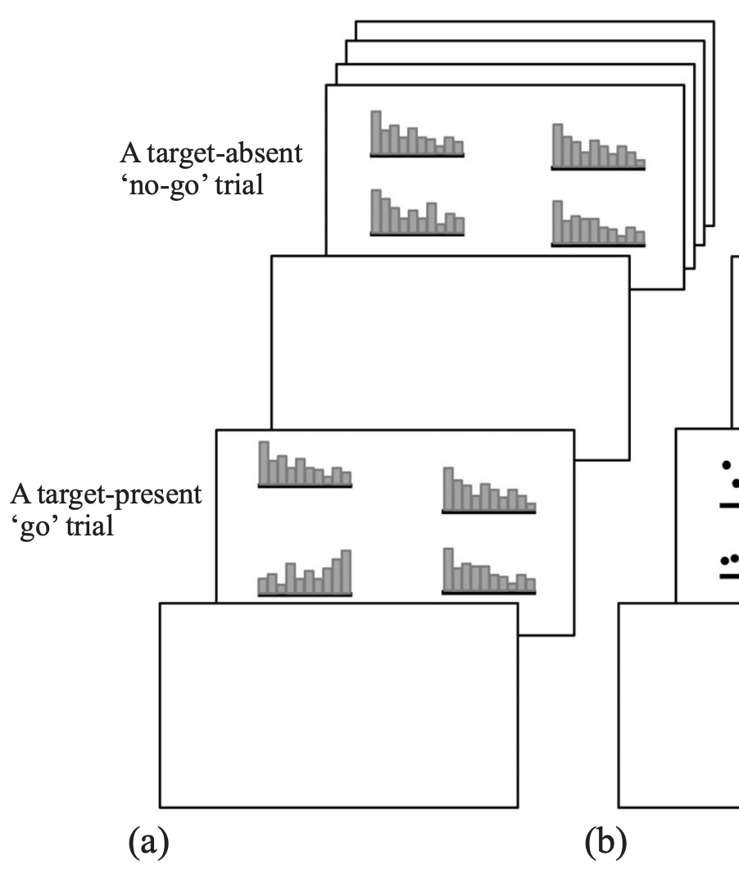
Method
Replicated Parrott et al. (2014)
Go/No-go visual search task
“Press space if you see an increasing/decreasing trend”

Slide 16
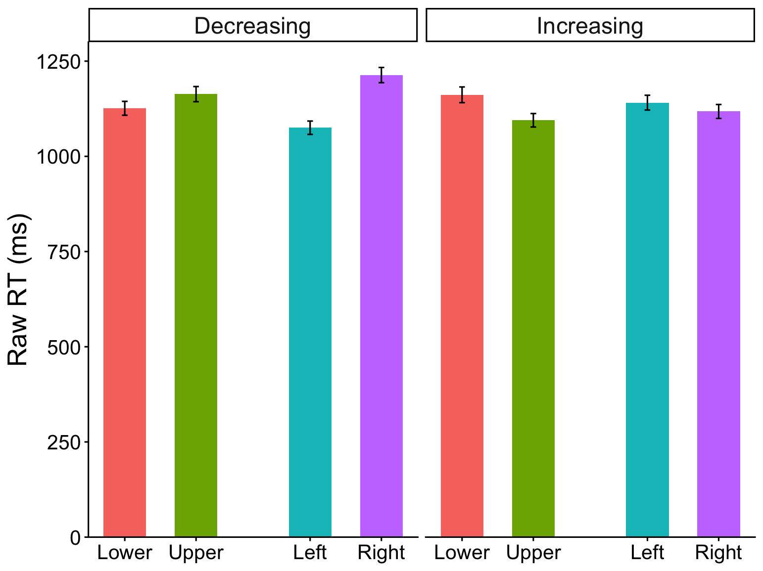
Question: are increasing graphs more slowly perceived in the lower and left and increasing in the upper and right?
Significant main effects of spatial position (all ps<.0001)
Significant interactions with trend (all ps<.0001)
Similar to Parrott: vertical and horizontal bias for decreasing trends and only vertical bias for increasing
***
***
***
ns

Slide 17
Is the canonical bias exacerbated with math experience?
Interaction among the upper-lower contrast of position, trend and math exp. (p=0.009; left versus right and diagonal contrast ps>0.1)
The effect appeared to differ by graph (p=0.056)
Effect of math on spatial-trend bias was significant only for bar graphs

Slide 18
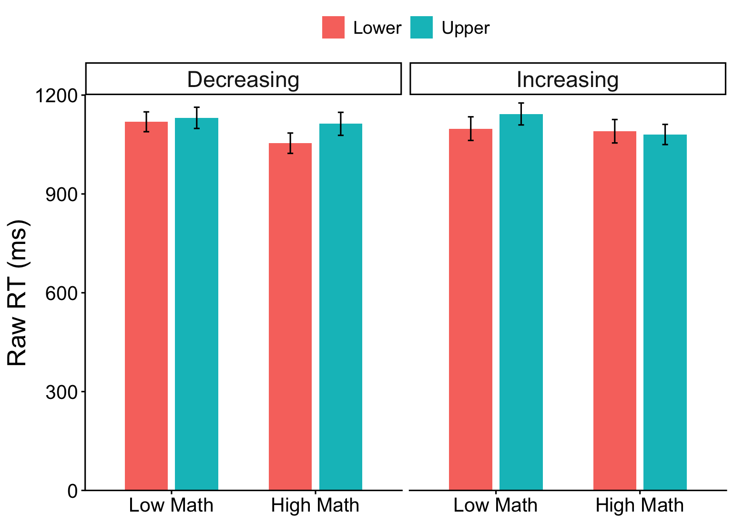
Is the canonical bias exacerbated with math experience?
Decreasing Trends: significantly larger and canonical upper-lower difference for math evaluated at High (+1 SD) compared to Low ( -1 SD) Math (b=-47.4, p=0.0465)
ns
*
*
ns
Increasing Trends: significantly larger reverse-bias upper-lower difference for math evaluated at High (-1 SD) compared to Low ( +1 SD) Math (b=61.8, p=0.011)
Bar Graphs

Slide 19
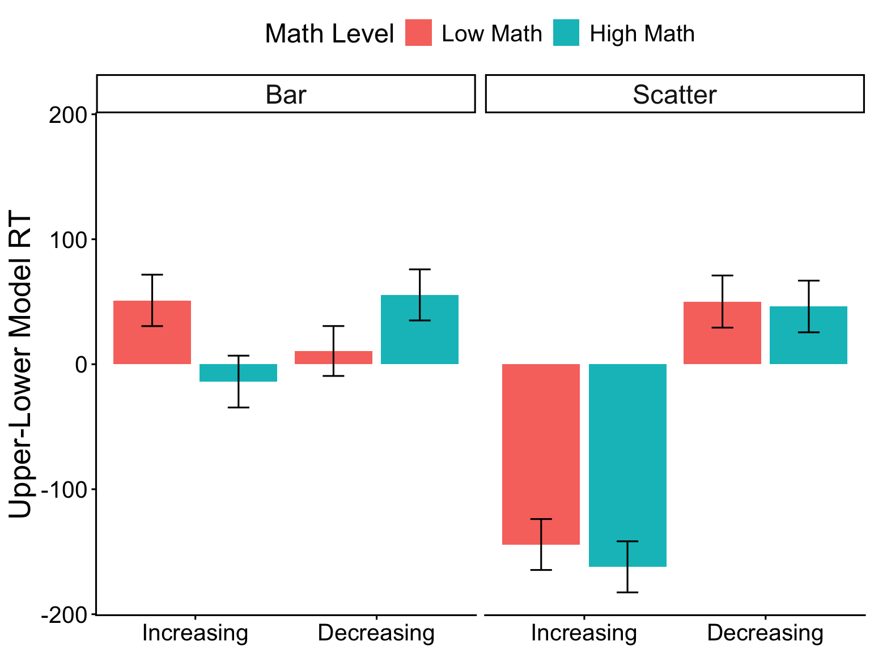
Is the canonical bias exacerbated with math experience?
Math experience did not influence biases in scatter plots or any horizontal biases
ns
*
*
ns

Slide 20
Discussion: spatial biases modulated by experience
Math experience modulated vertical but not horizontal biases
No effects in scatter plots
Cartesian coordinate grid used in math courses taken by all participants they may be similar to scatter plots; more experience with bar graphs might come from scientific endeavors
A reverse bias for increasing graphs that reduces with experience
Possibly a default bias to read graphs in the lower visual field that changes with experience

Slide 21
Big Question: what underlies graph perception?
Vertical bias learned through experience with graphs
Left-right bias might arise from shared spatial and relational bias to numerical magnitude (i.e.: Right-> Big <- Increasing)
Does graph perception really recruit such seemingly abstract mathematical thinking?

Slide 22
Study 2 Research Question
Do trends in graphs have numerical associations: does the numerosity of an array influence judgements of its trend depending on trend direction?

Slide 23
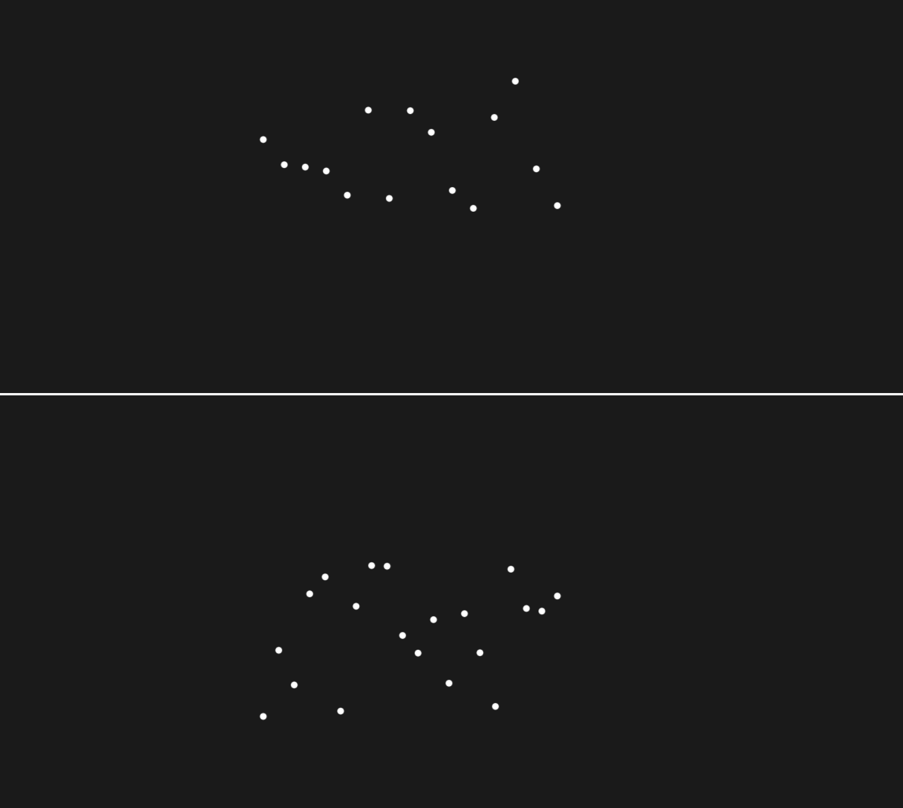
Method
Trend and Number task between-subjects
Arrays had few (8-14) or many (15-22) points with increasing or decreasing trends
Task: Compare bottom array to top neutral array with 0 trend and 15 points
Use P and Q to indicate if the trend above is (increasing/decreasing) or (more/less numerous) compared to bottom array

Slide 24
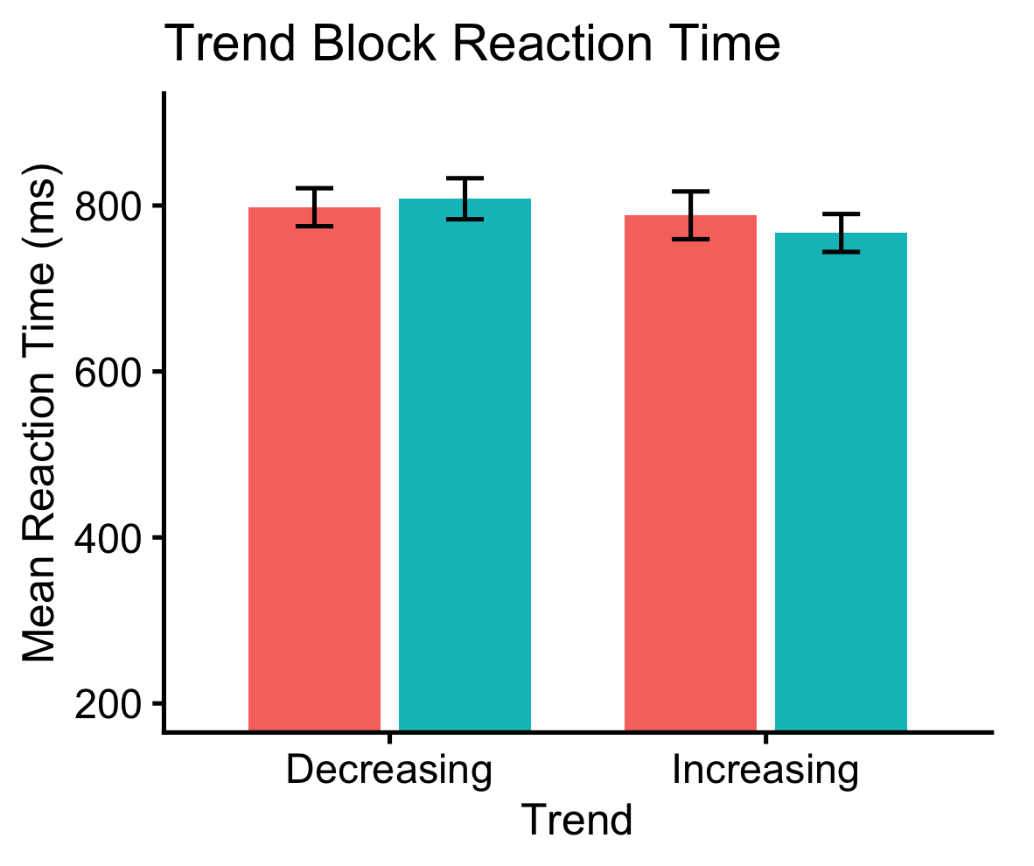
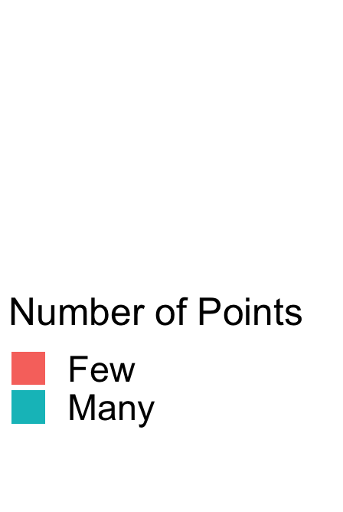
Does numerosity of an array influence judgements of its trend depending on trend direction?
More numerosity reduced reaction time for increasing trends but not for decreasing trends
(b = −0.034, SE = 0.011, z = −3.13, p = .0017)
ns
**

Slide 25
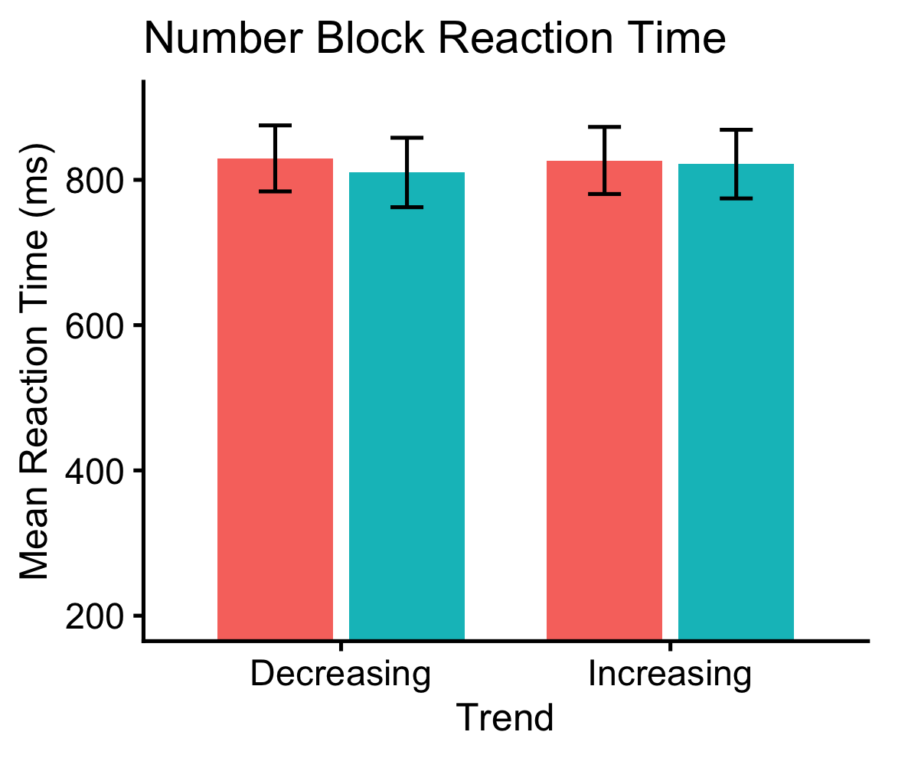
Does the trend of an array influence judgements of its numerosity?
Trend had no influence on judgements of numerosity
(b = 0.002, SE = 0.001, z = 1.66, p = .098)
ns
ns
**

